Slide 1
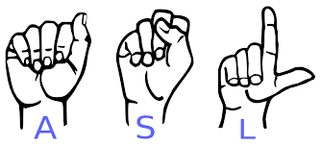
ASLingo Final Presentation
A Web Application to Help People Learn American Sign Language
1/22
Notes:
Andrew: Hi everyone, we’re ASLingo
<everyone signs their name, shuffle towards front of podium taking turns>
Jeremy: If you didn’t understand that, that’s okay because our app ASLingo is here to help you learn American Sign Language
<introductions in English>

Slide 2
Problem
Learning a new language can be a hard task that only gets more challenging with age, as individuals may find it difficult to dedicate time and effort to it.
2/22

Slide 3
Problem
Learning a new language can be a hard task that only gets more challenging with age, as individuals may find it difficult to dedicate time and effort to it.
American Sign Language (ASL) is particularly hard due to its visual and gestural nature, which is not found in other, verbal languages.
2/22

Slide 4
Problem
Learning a new language can be a hard task that only gets more challenging with age, as individuals may find it difficult to dedicate time and effort to it.
American Sign Language (ASL) is particularly hard due to its visual and gestural nature, which is not found in other, verbal languages.
There are not many applications users can use to ensure the way they are signing is correct, they can only learn how to recognize the signs performed by others.
2/22

Slide 5
Solution
ASLingo aims to ease that challenge by providing an online, easy-to-access web platform for individuals to learn new signs and test their comprehension at their own pace in a fun, interactive manner.
3/22

Slide 6
Solution
ASLingo aims to ease that challenge by providing an online, easy-to-access web platform for individuals to learn new signs and test their comprehension at their own pace in a fun, interactive manner.
With a focus on consistent effort and continuous feedback, ASLingo provides real-time guidance to ensure users stay on track to achieving their goals of learning ASL.
3/22

Slide 7
Solution
ASLingo aims to ease that challenge by providing an online, easy-to-access web platform for individuals to learn new signs and test their comprehension at their own pace in a fun, interactive manner.
With a focus on consistent effort and continuous feedback, ASLingo provides real-time guidance to ensure users stay on track to achieving their goals of learning ASL.
Through using ASLingo, we want our users to sign with confidence!
3/22

Slide 8
Demo
Notes:
Edward: Starting off, we have the homepage. This is the landing page of the application. It tells users about the app and contains a direct link to start learning with the app. As well, it explains our goal for the app and how the app works. Next,

Slide 9
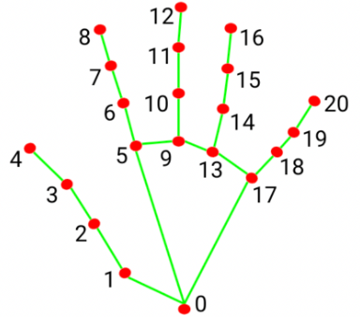

How it works
4/22
Notes:
Let’s go over on a surface level how everything works.
For hand recognition, we employed the use of Google’s Mediapipe’s hand tracking library to gather hand positioning data known as hand landmarks from the webcam. In the library, a hand is recognized through a series of 21 landmark coordinates, each of which are responsible for tracking the position of various points of the hand.

Slide 10
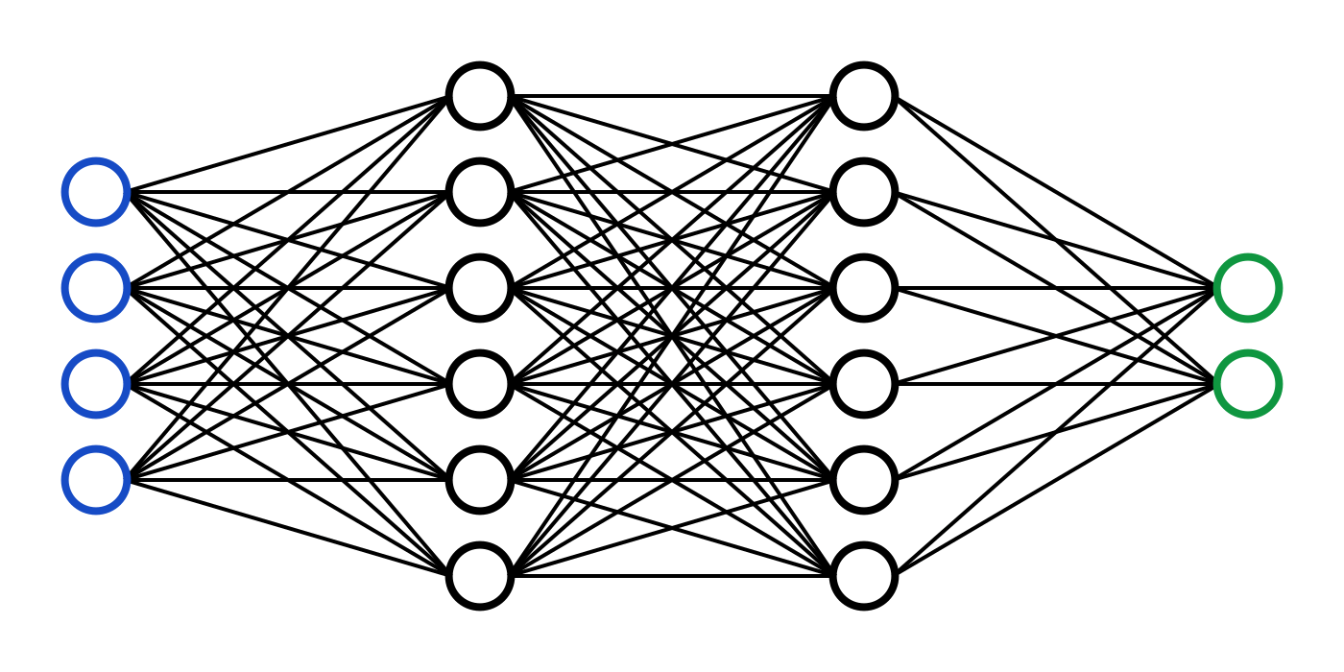
How it works
“R”
4/22
Notes:
Our model is a neural network trained on datasets consisting of these landmark data for each particular sign.

Slide 11
How it works
frame n
…
frame 2
frame 1
“hello”
4/22
Notes:
For dynamic sign recognition, the model is trained in a similar way, but on a compilation of 30 frames of landmark data to account for the movement of the hand.

Slide 12


How it works
User Browser
Server
web socket
data preprocessing
web socket
4/22
Notes:
For the app as a whole, landmark data is gathered from the user’s webcam and is sent to our backend server which runs preprocessing on the data and runs it through the model, which it then returns a result which is sent back to the user.

Slide 13
Training the Model
Notes:
Initially, we considered using third party open source datasets to train our machine learning model on. However, early on during development we realized that there weren’t that many resources or datasets out there for ASL signs, especially for our particular use case where we would want to include dynamic signs and the ability to add new words to the model.

Slide 14
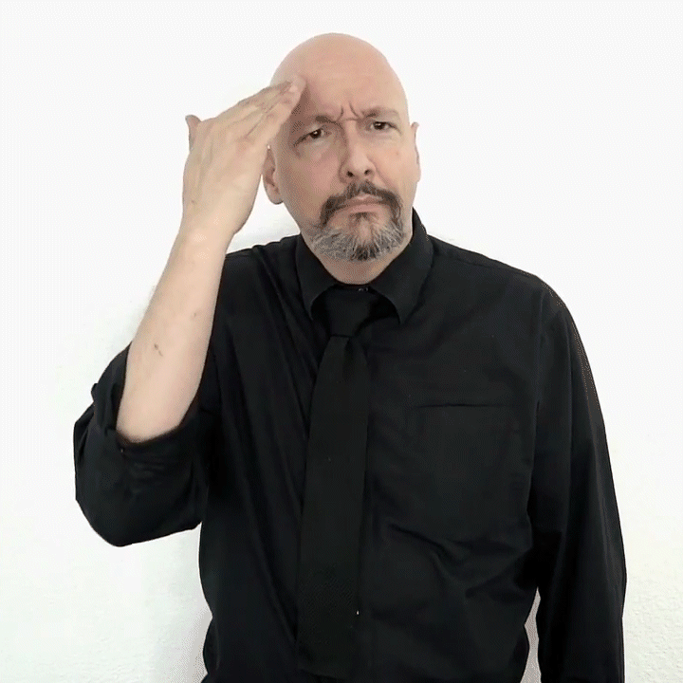
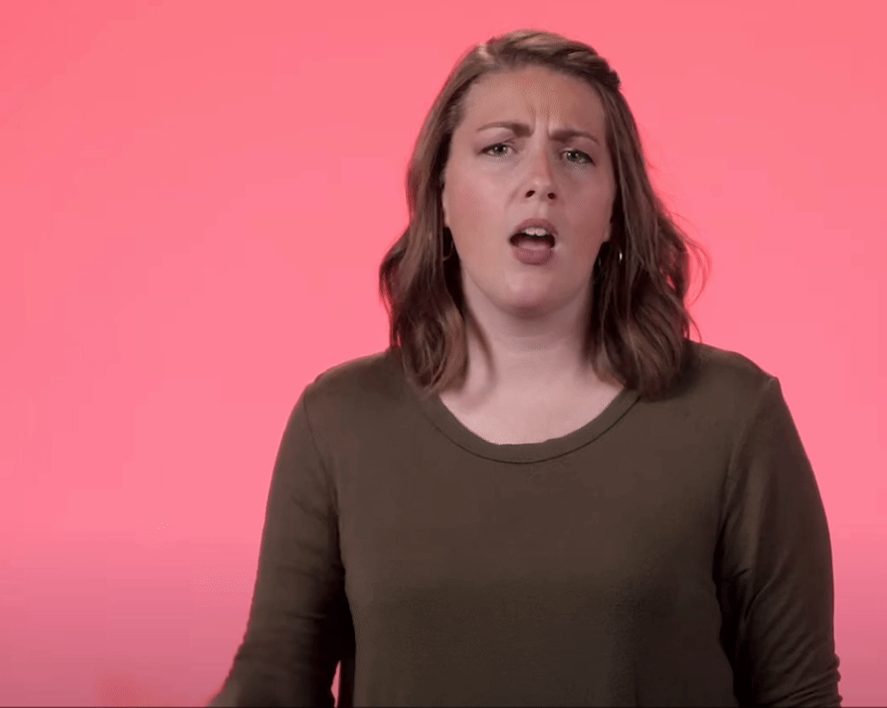
Training The Model
‘Why’ variant #1
‘Why’ variant #2
5/22
Notes:
Additionally, American sign language itself is not static and is continuously changing, with different variations for signs that existing datasets do not account for.

Slide 15
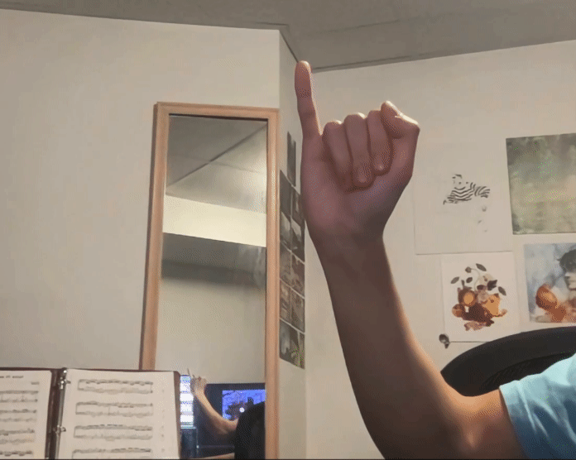

Training The Model
internal tools for gathering and performing necessary processing on data
compiled data for model training
Easy to add new signs or variations of signs to the model
5/22
Notes:
To address this, we decided to gather our own landmark data through our own internal tools. Through these tools, we were able to train our models through custom gathered data, making it easy for us to train the model on new words or hand signs, or for variations of signs that may exist.

Slide 16
Developing With Stakeholders
We developed this application with the help of our stakeholders; the McMaster Sign Language Club, to ensure that the learning resources provided in the application were using credible sources
6/22

Slide 17
Developing With Stakeholders
We developed this application with the help of our stakeholders; the McMaster Sign Language Club, to ensure that the learning resources provided in the application were using credible sources
They additionally served as consultants to help us gauge sign difficulty for beginners as well as the most common signs
6/22

Slide 18
Usability Testing
We did extensive user testing, including testing with stakeholders from the SLC who have lots of knowledge about ASL and testing with users who are completely new to learning this language to get a range of testing experiences.
7/22

Slide 19
Usability Testing
We did extensive user testing, including testing with stakeholders from the SLC who have lots of knowledge about ASL and testing with users who are completely new to learning this language to get a range of testing experiences.
Users were instructed through the app and asked to fill out a usability survey afterwards which utilized a Likert Scale for data, as well as providing verbal feedback to the testers.
7/22

Slide 20
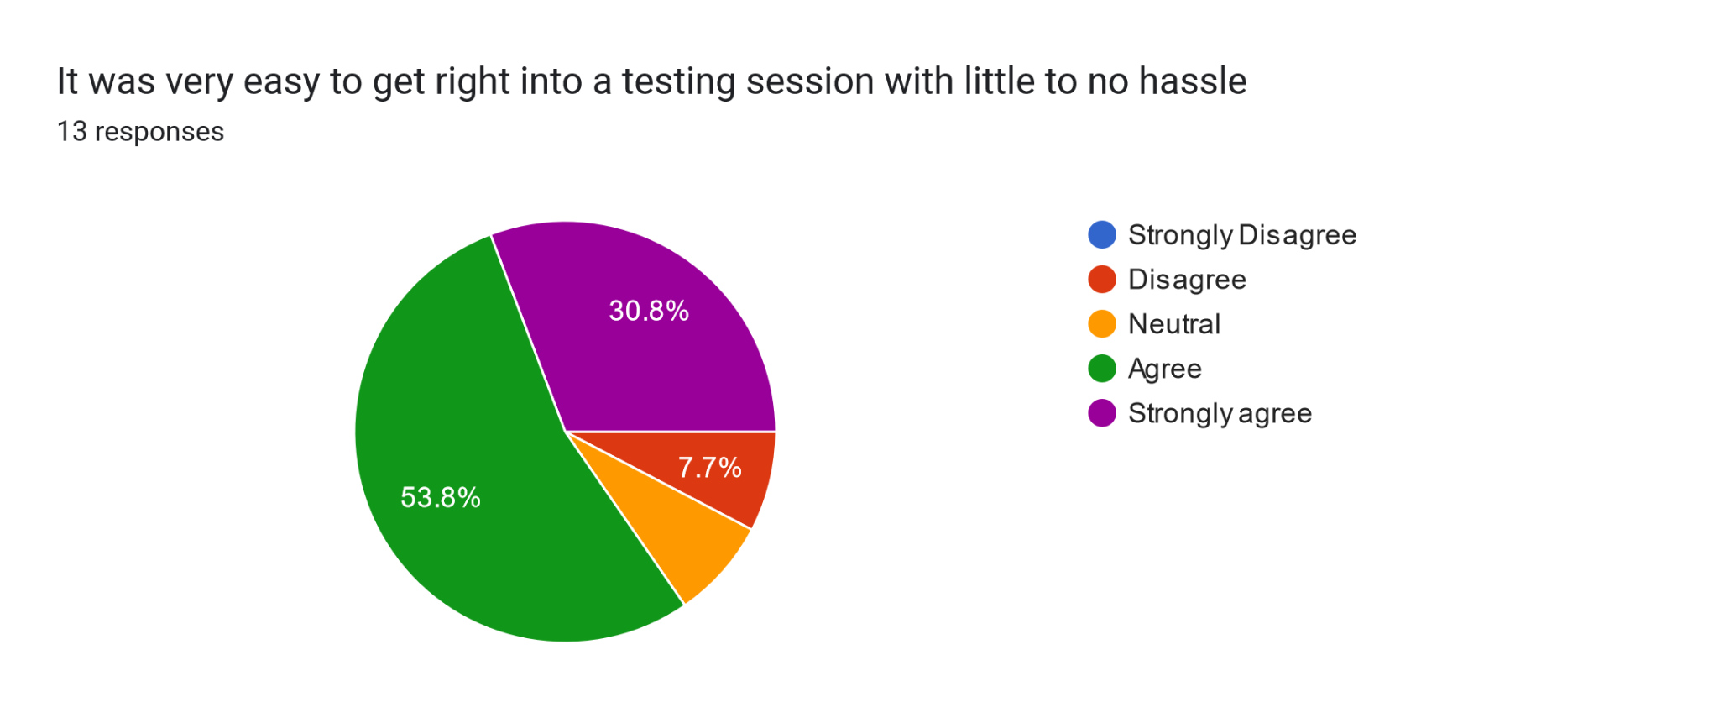
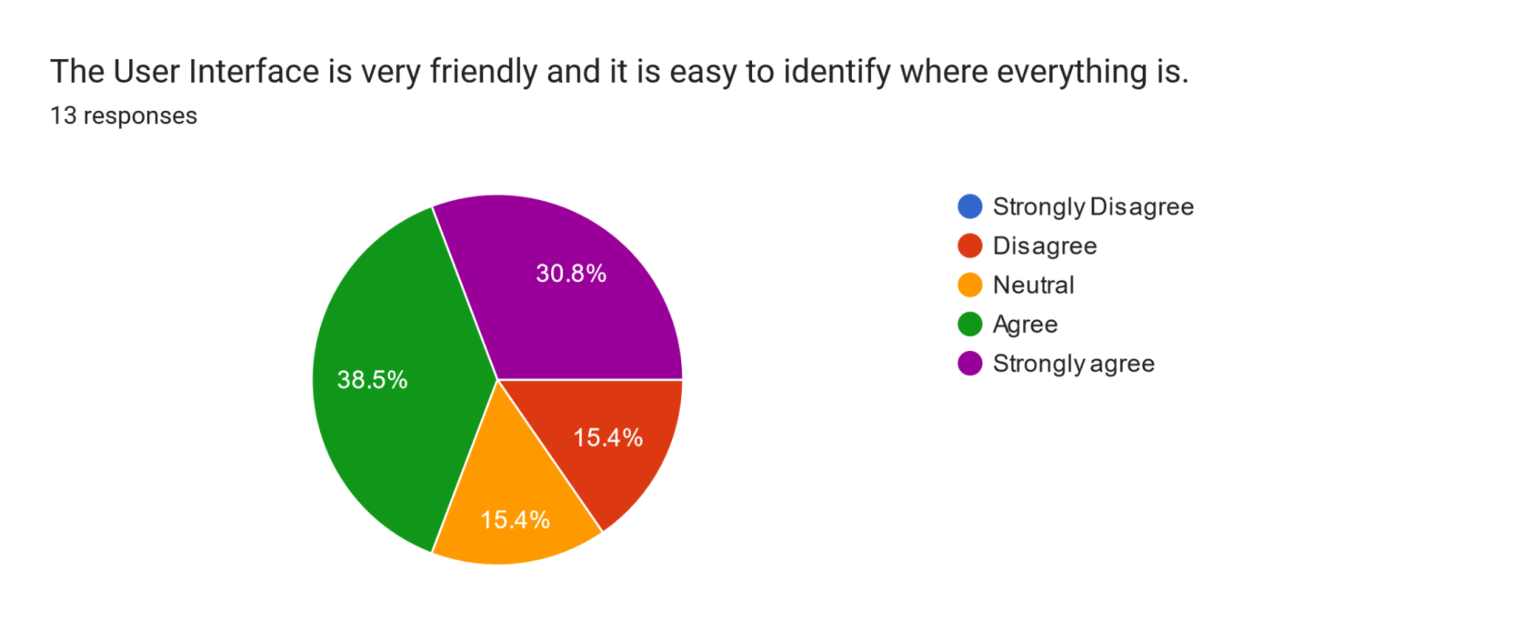
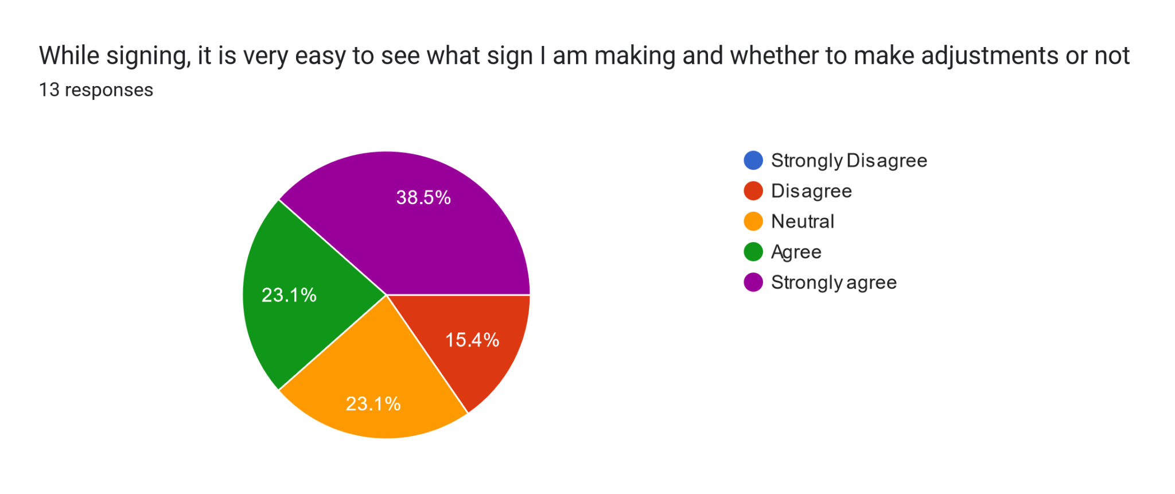
Usability Data
8/22

Slide 21
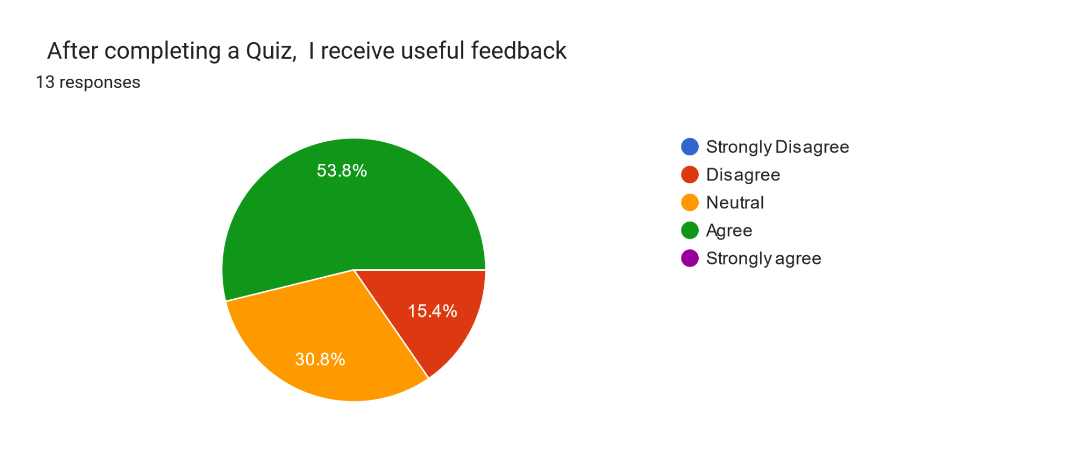
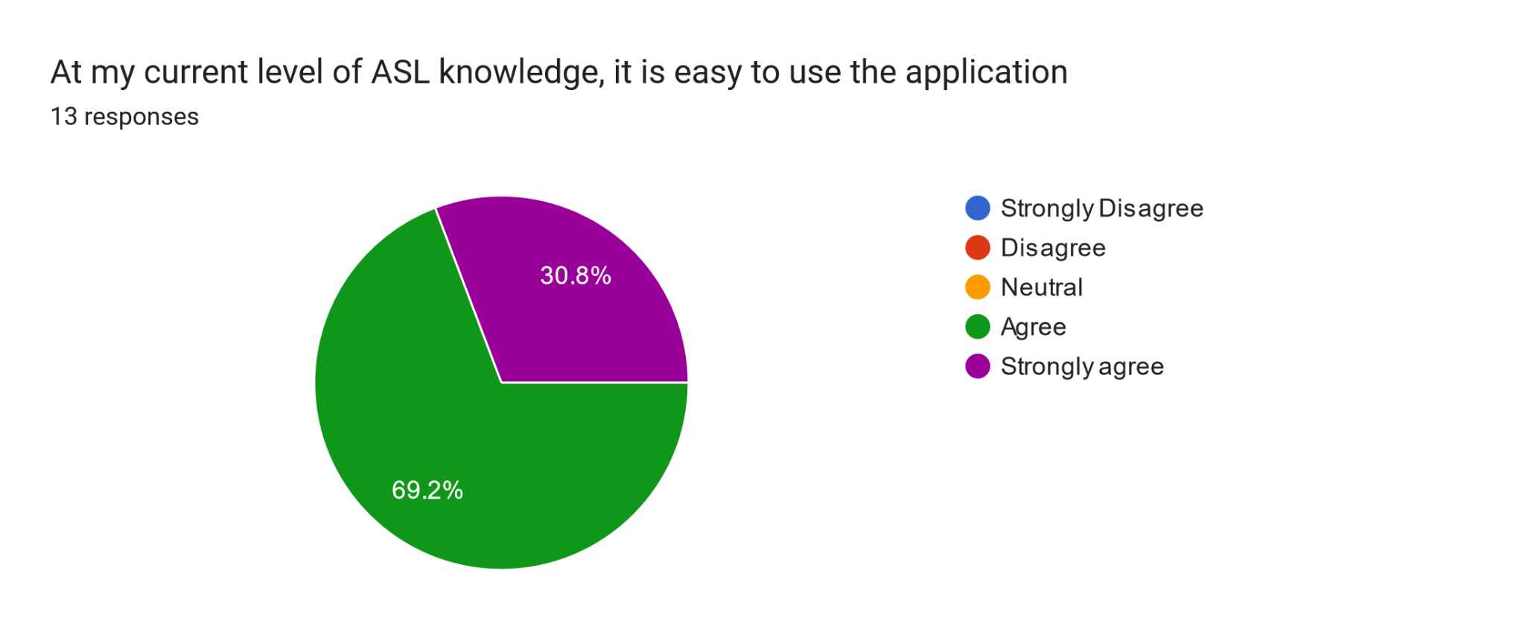
Usability Data
9/22

Slide 22
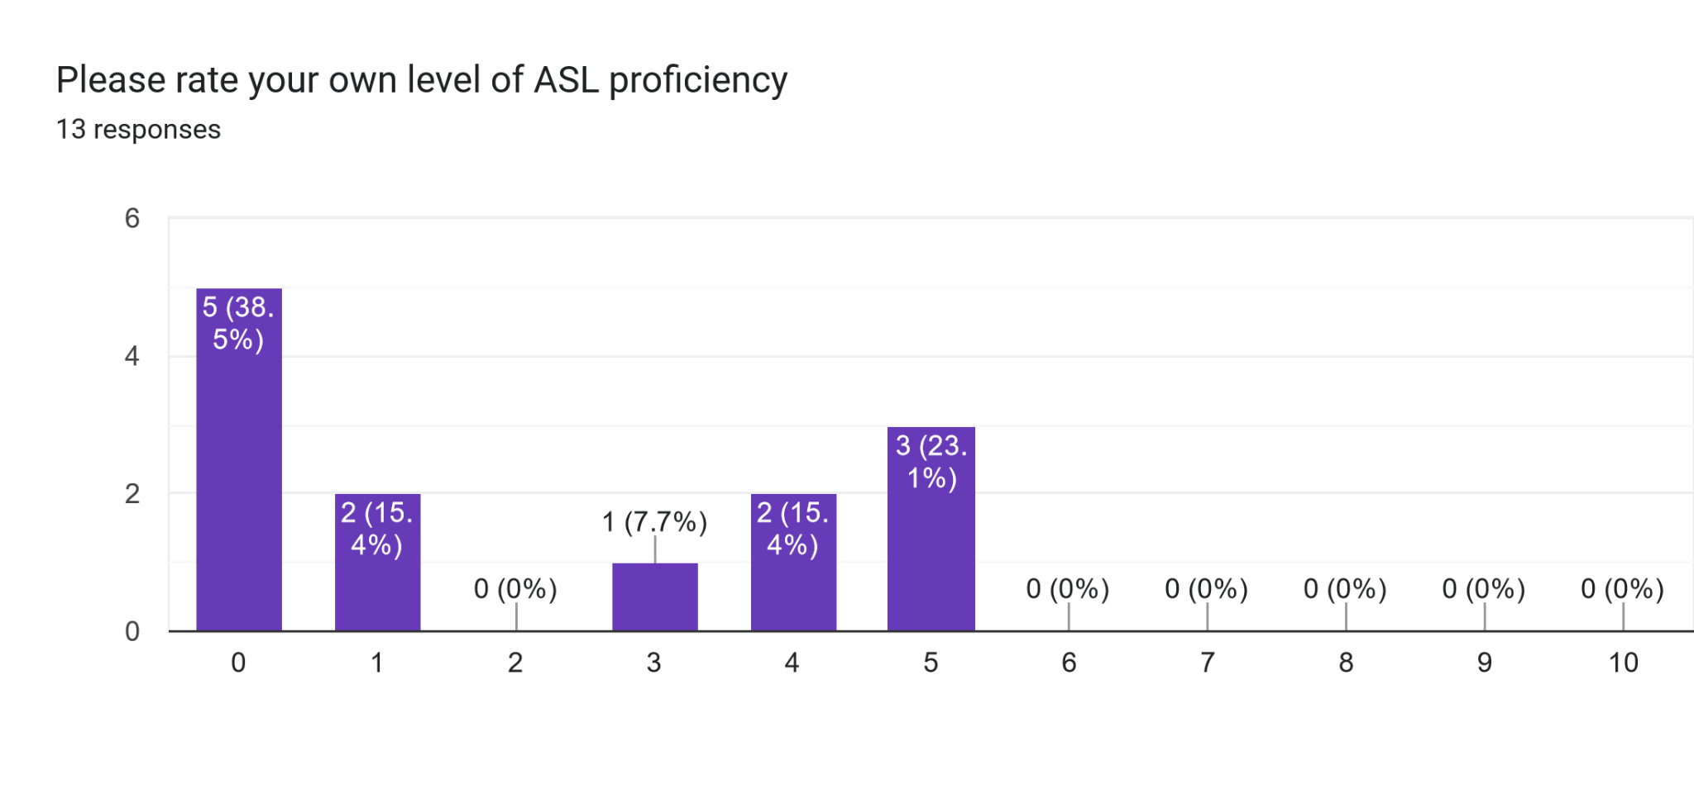
Q: “Please rate your own level of ASL proficiency”
10/22

Slide 23
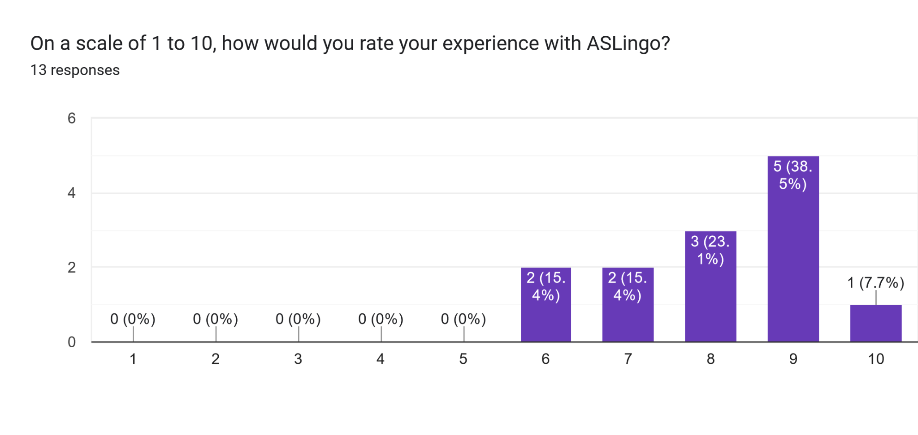
Q: “On a scale of 1 to 10, how would you rate your experience with ASLingo?”
11/22
Notes:
Average is about 8

Slide 24
What Makes ASLingo Different?
ASLingo | Existing Projects
Provides a platform for learning and practicing hand signs | Provides only short form videos teaching hand signs
12/22
Notes:
Let’s move on to what makes ASLingo stand out from current market solutions and other similar projects.
There are already numerous applications whose aim is to educate people in American Sign Language. However, most of these solutions offer limited scope in their teaching methods.

Slide 25
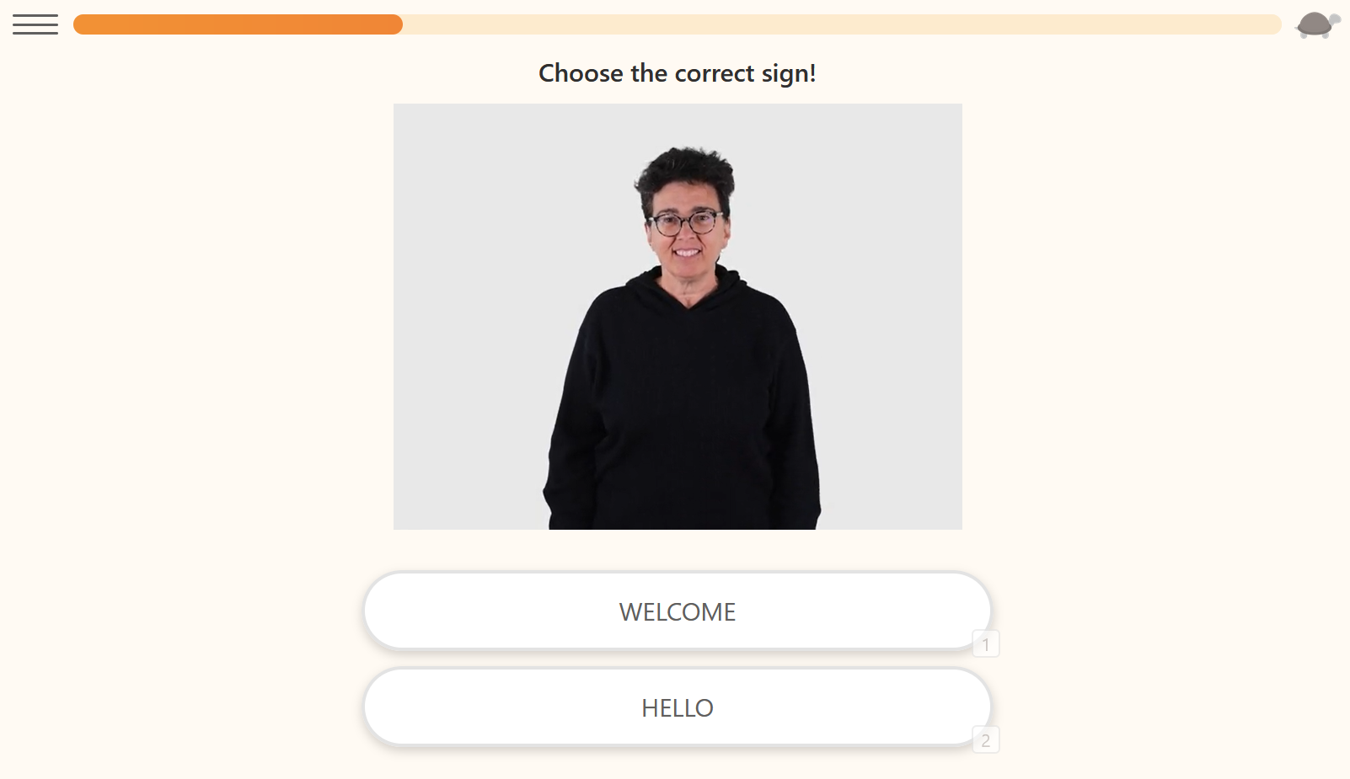

Current Market Solutions like “Lingvano” only have basic assessment capabilities
13/22
Notes:
For instance, Lingvano, a popular platform, primarily provides short-form videos that teach users individual signs.
While this approach has its merits, it falls short in offering a comprehensive learning experience. The assessment capabilities are basic and don’t allow learners to practice what they’ve learned.

Slide 26
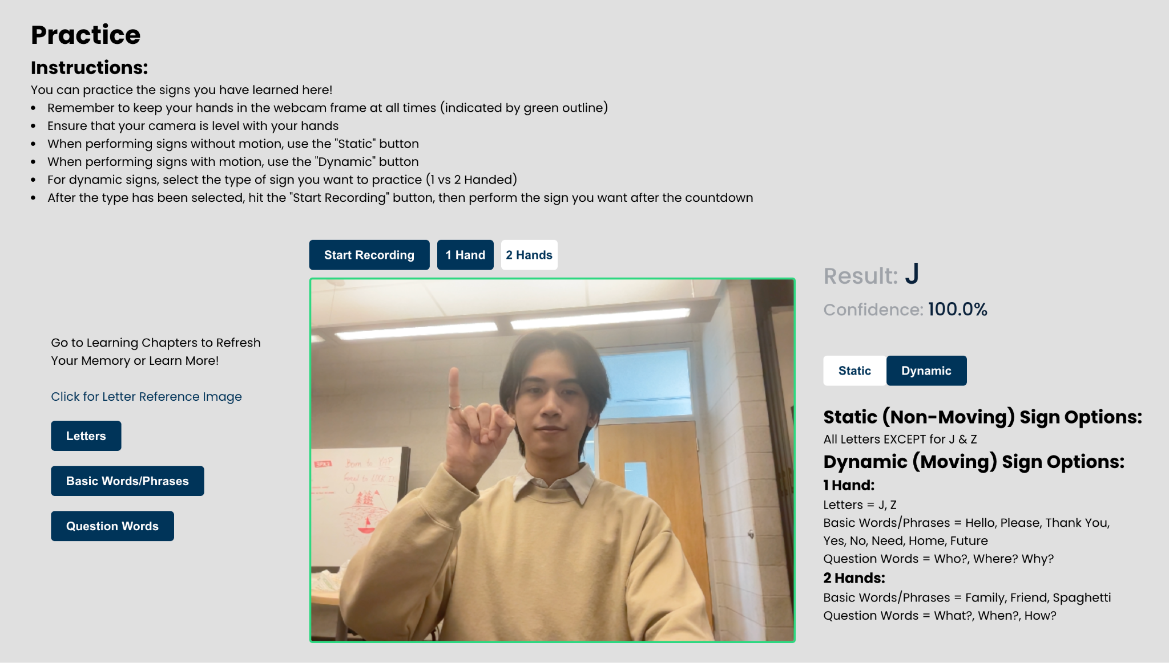
14/22

Slide 27
What Makes ASLingo Different?
ASLingo | Existing Projects
Provides a platform for learning and practicing hand signs | Provides only short form videos teaching hand signs
Detects static AND dynamic hand signs | Detects only alphabet hand signs
15/22
Notes:
In contrast, ASLingo provides a platform not only for learning signs but also for assessment.
This dual approach is crucial for improving proficiency in ASL, as it goes beyond mere recognition to active usage of the language.
Moreover, many previous capstone projects have focused exclusively on teaching the alphabet hand signs using static frame capture technology.
This is what Dr. Smith has informed us of and to differentiate us from other projects, we wanted to be able to detect moving or dynamic hand signs.
American Sign Language is a language that focuses really heavily on communication via movement.
So, with ASLingo, we’re able to better capture the full, dynamic nature of ASL.

Slide 28
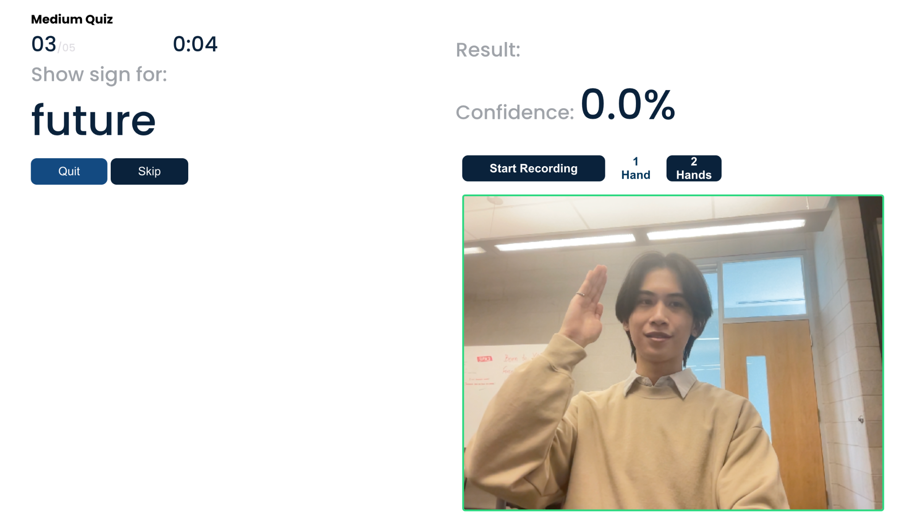
16/22
Notes:
This capability allows for a far more extensive selection of signs to be implemented, providing a richer learning experience that mirrors real-life ASL communication more closely.

Slide 29
What Makes ASLingo Different?
ASLingo | Existing Projects
Provides a platform for learning and practicing hand signs | Provides only short form videos teaching hand signs
Detects static AND dynamic hand signs | Detects only alphabet hand signs
Training data can be provided by anyone via data gathering system | Many datasets are biased to factors like skin colour and don’t include frame data for dynamic signs
17/22
Notes:
Another critical aspect where ASLingo differs is in the quality and nature of the data used for machine learning.

Slide 30
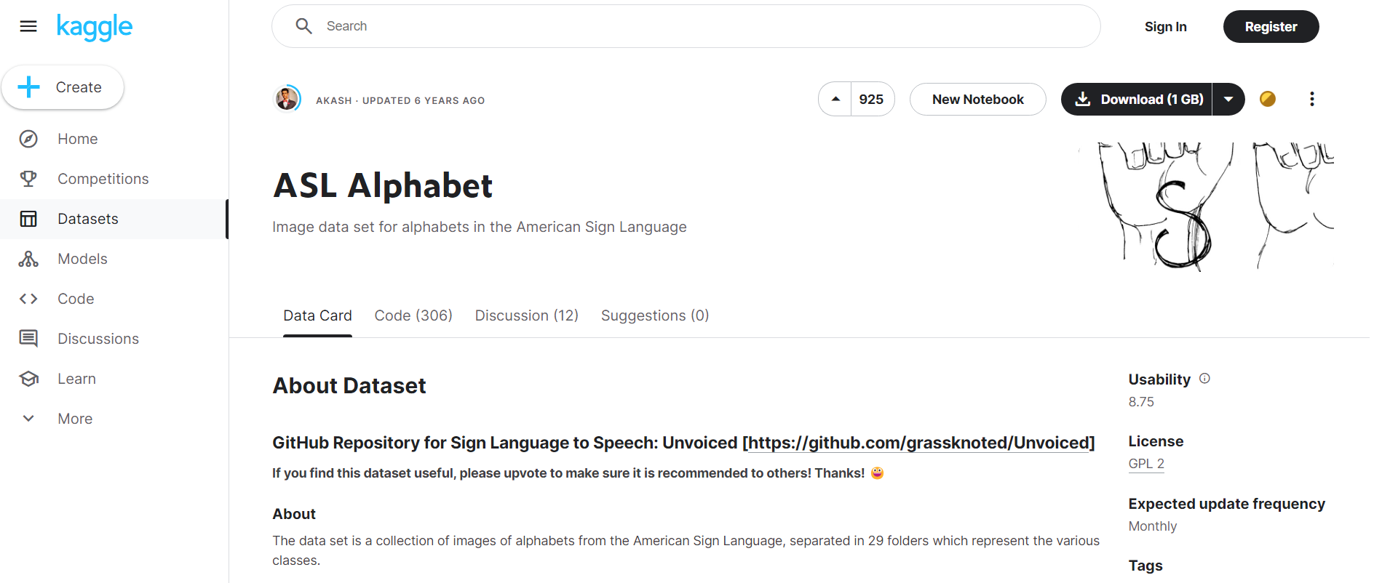
18/22
Notes:
Many other ASL machine learning projects suffer from biases in their datasets and a lack of dynamic hand sign data.
In fact, there is very minimal publicly available data for these projects to train on.
This lack of quality and usable data not only significantly hampers the effectiveness of the learning experience but also limits developers to being able to implement computer vision for only the alphabet for example.

Slide 31
What Makes ASLingo Different?
ASLingo | Existing Projects
Provides a platform for learning and practicing hand signs | Provides only short form videos teaching hand signs
Detects static AND dynamic hand signs | Detects only alphabet hand signs
Training data can be provided by anyone via data gathering system | Many datasets are biased to factors like skin colour and don’t include frame data for dynamic signs
19/22
Notes:
ASLingo addresses this issue by sourcing data directly from our hand signs data gathering tool.
We made sure to consult with the McMaster Sign Language Club to ensure the correctness and authenticity of the signs being taught.
This collaboration has been instrumental in creating a more accurate and unbiased learning platform.
In conclusion, ASLingo stands out in the market by offering a more interactive and comprehensive learning experience, dynamic sign detection implementation, and ensuring the accuracy and authenticity of the signs taught.

Slide 32
Roadmap

Slide 33
Real-time sign recognition for both static and dynamic signs
Custom in-house data gathering system for greater control of the model
Modularity of sign dataset allowing for ease of new additions
Version 1.0
20/22

Slide 34
Expanded vocabulary and faster recognition response times
User progression tracking via account and historical data
Initial calibration to ensure level camera and signs can be done within reasonable space in frame
Version 1.1
21/22
Notes:
One future improvement to make is implementing user account progressions. This will increase user engagement and commitment to learning ASL if they are given progression based exercises and can see historical data on their progression.
An initial calibration could increase user experience by ensuring all the users hand signs are going to be properly captured and analyzed

Slide 35
Full phrase tracking and testing
Facial recognition to aid in sign recognition
Variations in common signs
Hand and body position differences
Version 1.X and Beyond
22/22
Notes:
For static signs, our current application predicts the user’s hand sign near instantaneously with a certain confidence level. However, since a lot of the static signs are similar to each other, the model predicts any hand sign, even if it is not a valid sign, with high confidence. A potential solution to this issue would be to consider a list of the most recently signed signs and only output the sign that appears the most (and is over a certain threshold).

Slide 36
Questions?

